Slide 1
Infosys Springboard Virtual Internship
Project Name: Food Trends Understanding Customer Preferences
Group ID: Group 1, Batch-11
Mentor: Ms.Nityasree
Jai Akash L J

Slide 2
Objective
Dominant Platforms: Identifying key ordering platforms utilized by customers.
Customer Preferences: Analyzing food choices, dietary patterns, and preference trends.
Delivery Experience: Evaluating service satisfaction, wait time, and delivery efficiency.
Data-Driven Decisions: Supporting insights for informed and strategic decision-making.
Performance Evaluation: Assessing restaurant ratings, service quality metrics, and promotion effectiveness.
Customer Decision Factors: Understanding the impact of affordability, health concerns, and trust factors on ordering behavior.

Slide 3
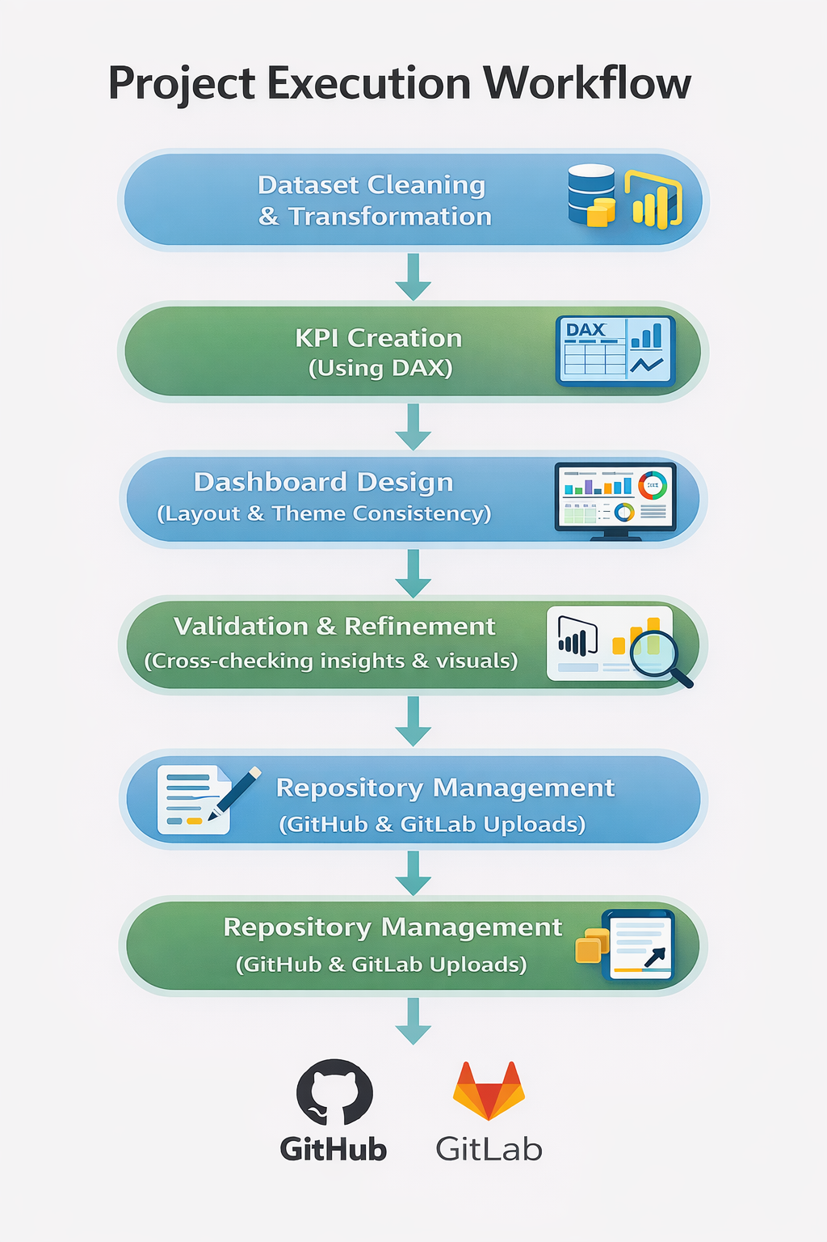
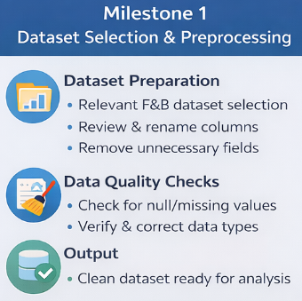
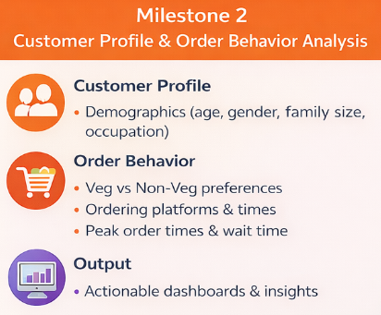
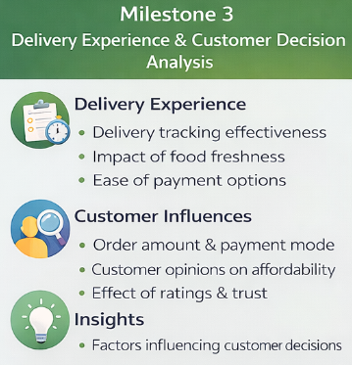
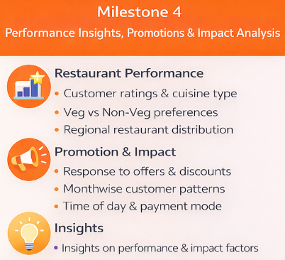
Project milestones:

Slide 4
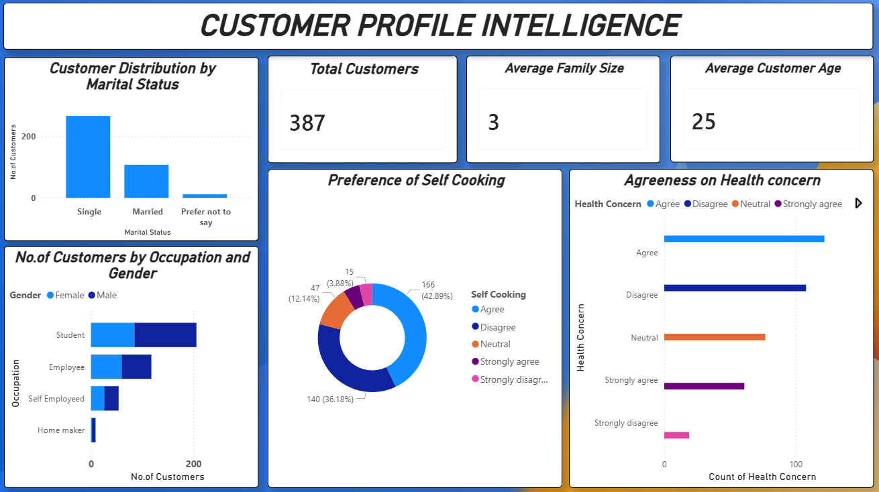
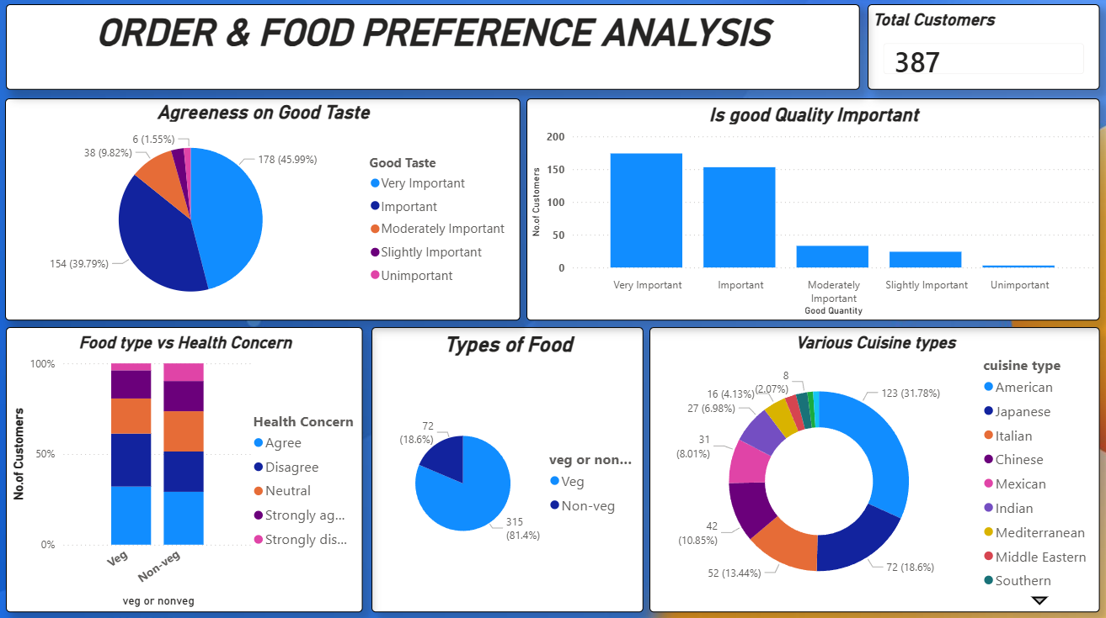
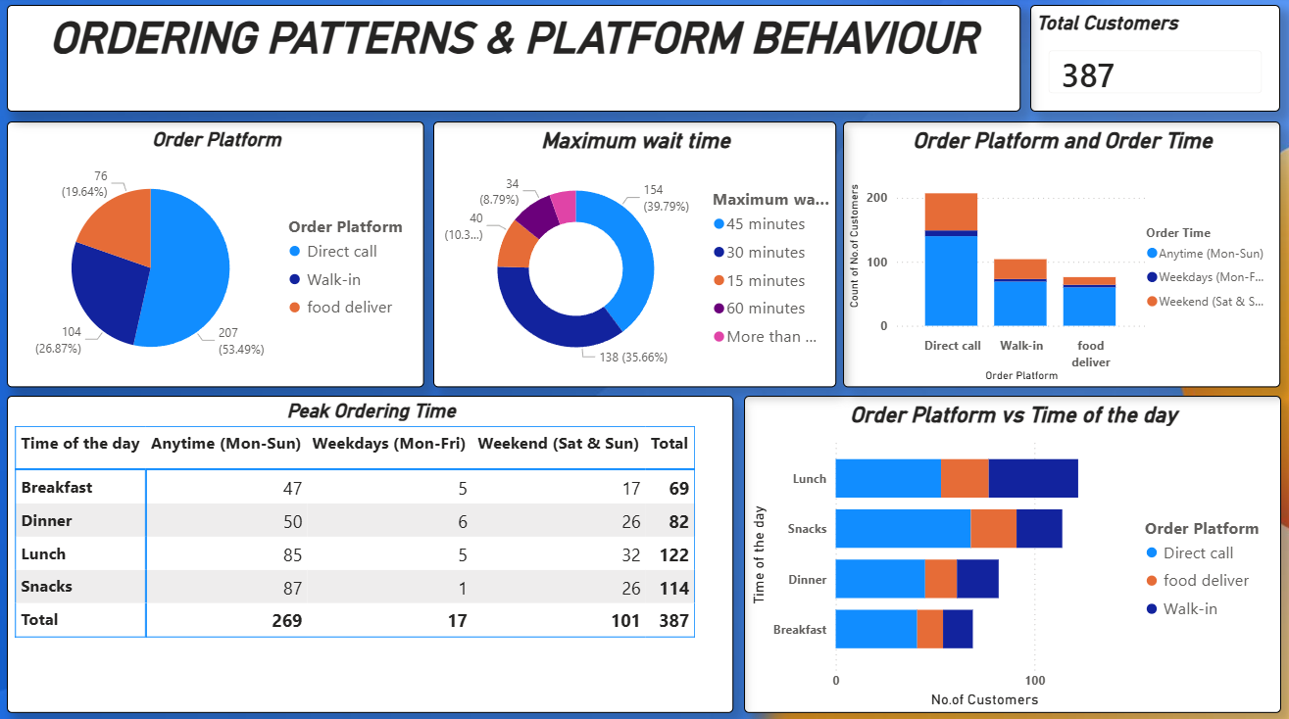
SNAPSHOTS:

Slide 5
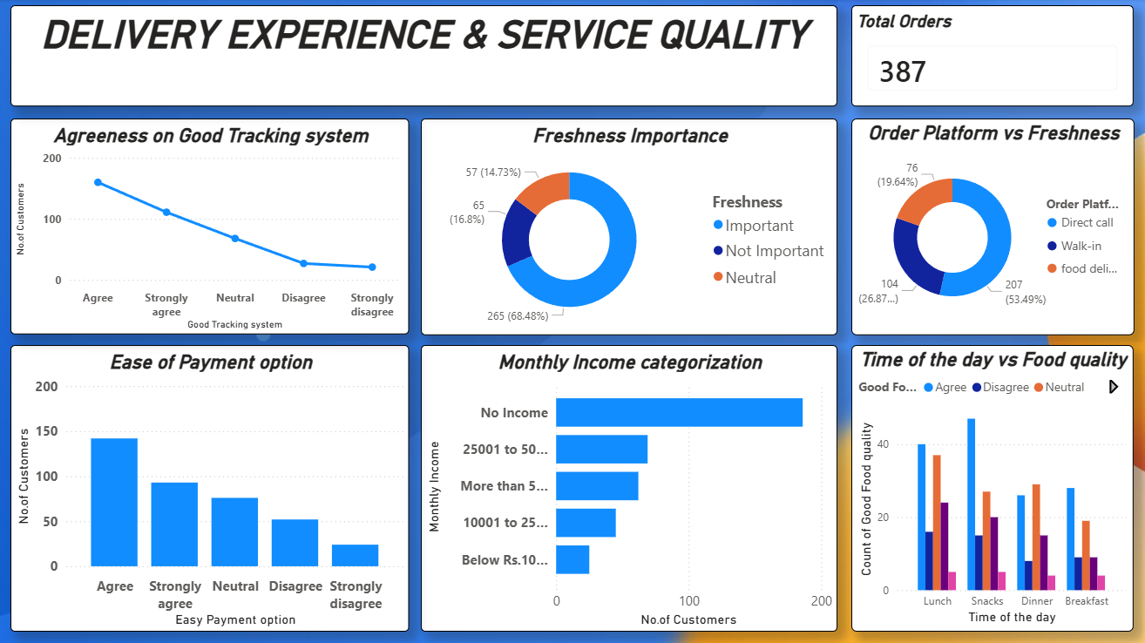
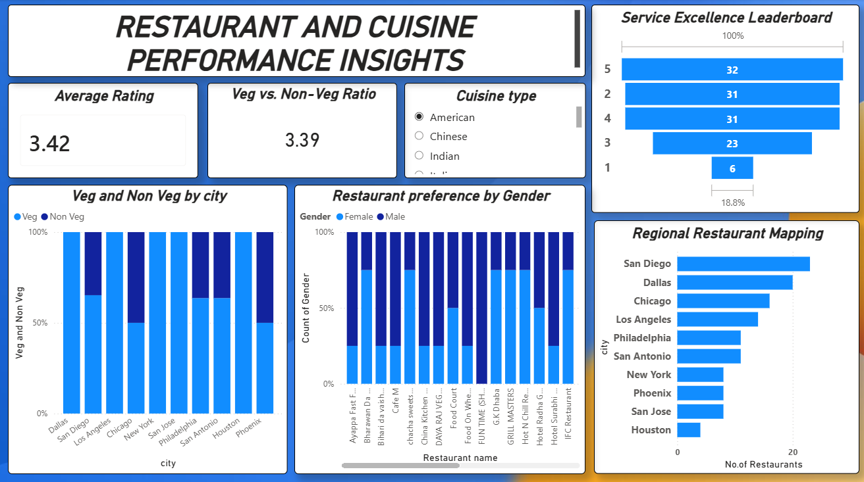
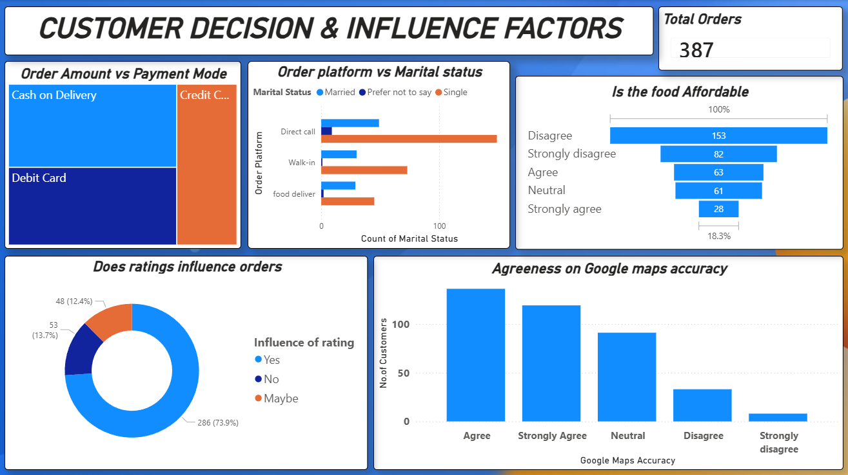
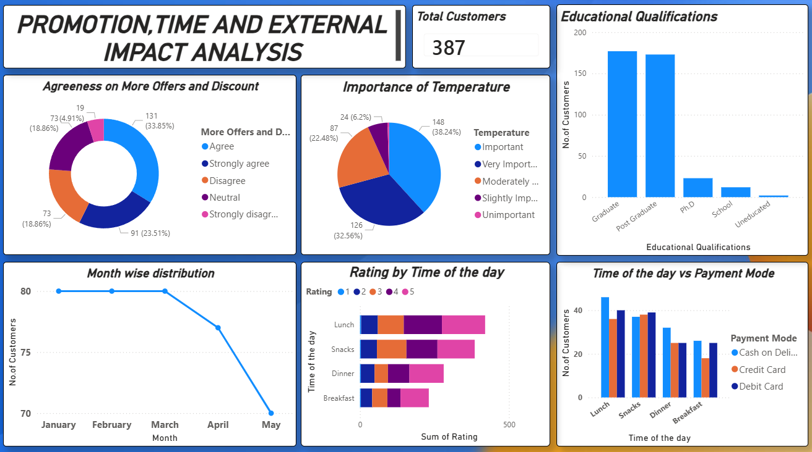

Slide 6
Challenges Faced
Power BI Service does not support true parallel dashboard editing, making simultaneous team collaboration difficult.
Each update required publishing changes and pulling the latest version from the cloud.
During data preprocessing, a column was accidentally deleted and went unnoticed initially.
The issue was identified only after progressing further in the analysis, affecting data consistency and visuals.
Resolution & Learnings
Adopted a sequential editing workflow for Power BI dashboards.
Assigned clear responsibility for report updates to avoid conflicts.
Recovered the deleted column by copying and matching it from the original dataset.
Revalidated preprocessing steps, relationships, and visuals after recovery.
Reinforced the importance of validation checks during data preprocessing in Power BI.

Slide 7
Learnings and skills used
Data Analytics & Visualization Skills
Interactive Dashboards: Cross-filtering and user-driven exploration
DAX (Basics): Built measures using AVERAGE and COUNT for KPIs
Visual Analytics:
Bar charts for cuisine preference analysis
Column charts for behavioral comparison
KPI cards to highlight key metrics
Data Transformation:
Cleaned and prepared data using Power Query
Handled missing values and corrected data types
Tools & Technologies
Power BI
Designed interactive dashboards for customer behavior analysis
Used a consolidated dataset to generate insights
Applied slicers and filters (City, Gender, Monthly Income) for dynamic analysis
Created clear and intuitive reports to support data-driven decisions
Microsoft Excel
Used for data entry, cleaning, and validation
Performed sorting, filtering, and consistency checks
Analyzed dataset structure before importing into Power BI
Soft Skills
Analytical Thinking: Interpreted visual trends to derive meaningful insights
Attention to Detail: Ensured data accuracy during cleaning and validation
Problem Structuring: Broke down business questions into measurable metrics
Presentation Clarity: Organized dashboards for easy interpretation by users
Iterative Improvement: Refined dashboards based on feedback and insights

Slide 8
Key insights
Future Enhancements
Implement predictive analytics to forecast customer demand and peak ordering periods.
Integrate real-time or regularly refreshed data to keep dashboards up to date.
Perform advanced customer segmentation based on ordering behavior and preferences.
Expand the dataset to include longer time periods for trend and seasonal analysis.
Incorporate automated data validation checks during preprocessing to reduce errors.
Apply machine learning–based customer segmentation (clustering) to group customers by ordering behavior and preferences.
Lunch and snack hours experience the highest customer demand.
Food quality has a strong influence on customer purchase decisions.
Faster delivery times are associated with higher customer satisfaction and ratings.
Affordability plays a major role in influencing orders, particularly among students and low-income customers.

Slide 9
Conclusion
This project successfully analyzed customer ordering behaviour and food preferences using Power BI dashboards.
The analysis transformed raw data into meaningful and actionable insights through effective visualization.
Key patterns related to ordering platforms, time preferences, and quality expectations were clearly identified.
Challenges faced during team collaboration and data preprocessing were resolved using structured workflows and validation checks.
The project demonstrated the practical application of data analytics concepts in a real-world scenario.
It strengthened understanding of the end-to-end analytics lifecycle, from data preprocessing to insight generation.
The project also highlighted the importance of collaboration, version control, and data accuracy when working with enterprise analytics tools.

Slide 10
References
Microsoft Power BI Documentation.
Infosys Springboard Virtual Internship course materials.
Acknowledgement
We would like to express our heartfelt gratitude to: Infosys Springboard Team– for organizing this valuable internship opportunity.
Our Mentor– for her continuous support and feedback.
My Teammates – for collaboration, encouragement, and insights.
This internship has been a significant step in our professional growth and technical journey.

Slide 11

Thank you

